Slide 1
Chapter 3
Overflow and Multiplication
Supplementary Slides
Prepared by Fairoz Nower Khan

Slide 2
Lecture 14
Overflow
Long Multiplication
Optimized Multiplication
Faster Multiplier (basics)
MIPS Multiplication
Slides prepared by Fairoz Nower Khan Miss

Slide 3
Arithmetic for Computers
§3.1 Introduction
Operations on integers
Addition and subtraction
Multiplication and division
Dealing with overflow
Floating-point real numbers
Representation and operations

Slide 4
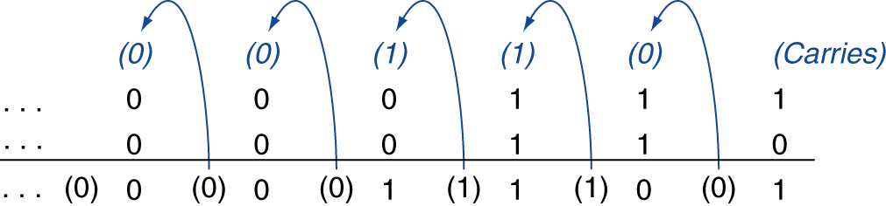
Integer Addition
Example: 7 + 6
§3.2 Addition and Subtraction
Overflow if result out of range
Adding +ve and –ve operands, no overflow
Adding two +ve operands
Overflow if result sign is 1
Adding two –ve operands
Overflow if result sign is 0

Slide 5
Overflow when Addition
Range for n bit Signed Number = -2^(n-1) to + 2^(n-1)-1
No overflow: when adding one positive and one negative binary number
Range for 5 bit signed number = -2^(4) to +2^(4)-1
= -16 to +15
0 1 0 1 1 (11)
0 0 0 0 1 (1)
1 1 1 1 1 (-1)
1 1 1 1 0 (1’s complement)
1 1 1 1 1 (2’s complement)
0 1 0 1 0 (10)
Overflow: when adding two positive binary numbers
Overflow if sign bit of result is 1
2’s Complement to Decimal Conversion
11010 = -2^4 + 2^3 + 2^1
= -16 + 8 + 2 = -6
0 1 0 1 1 (11)
0 1 0 1 0 (10)
0 1 1 1 1 (15)
0 1 1 0 0 (12)
1 1 0 1 0 (-6)
1 0 1 1 0 (-10)
Overflow: when adding two negative binary numbers
Overflow if sign bit of result is 0
1 0 1 0 1 (-11)
2’s Complement to Decimal Conversion
100110 = -2^5 + 2^2 + 2^1
= -26
1 0 0 0 1 (-15)
0 0 1 1 0 (6)
1 0 0 1 1 0 (-26)

Slide 6
Integer Subtraction
Add negation of second operand
Example: 7 – 6 = 7 + (–6)
+7: 0000 0000 … 0000 0111 –6: 1111 1111 … 1111 1010 +1: 0000 0000 … 0000 0001
Overflow if result out of range
Subtracting two +ve or two –ve operands, no overflow
Subtracting +ve from –ve operand
Overflow if result sign is 0
Subtracting –ve from +ve operand
Overflow if result sign is 1
3 - 15 = -12
-11 - (-14) = -3

Slide 7
Overflow when Subtraction
Range for 5 bit signed number = -2^(4) to +2^(4)-1
= -16 to +15
Overflow: when subtracting a negative number from a positive number
Overflow if sign bit of result is 1
3 - (-15) = 3 + 15
0 0 0 1 1 (3)
1 0 0 0 1 (-15 in 2’s complement)
0 1 1 1 1 (15)
1 0 0 0 0 (1’s complement)
1 0 0 0 1 (-15)
1 0 0 1 0 (-14)
0 1 1 1 1 (15)
Overflow: when subtracting a positive number from a negative number
Overflow if sign bit of result is 0
-8 - 10 = -18
1 1 0 0 0 (-8)
0 1 0 1 0 (10)
1 0 1 1 0 (-10)
0 1 0 1 0 (10)
1 0 1 0 1 (1’s complement)
0 1 1 1 0 (14)
1 0 1 1 0 (2’s complement)

Slide 8
Dealing with Overflow
Program Counter (PC)
Address of the instruction with overflow
Some languages (e.g., C) ignore overflow
Use MIPS addu, addui, subu instructions
Other languages (e.g., Ada, Fortran) require raising an exception
Use MIPS add, addi, sub instructions
On overflow, invoke exception handler
Save PC in exception program counter (EPC) register
Jump to predefined handler address
mfc0 (move from coprocessor reg) instruction can
retrieve EPC value, to return after corrective action
Exception Program Counter (EPC)
Address of the instruction with overflow
Jump to the function which handles overflow
Retrieve EPC address using mfc0 and resume instruction

Slide 9
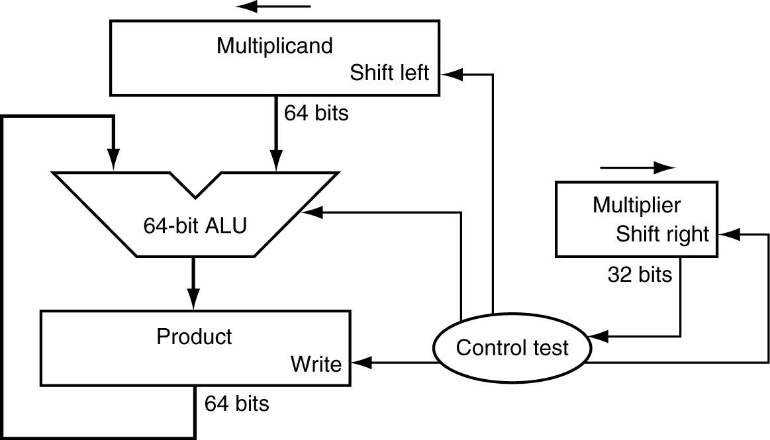
Multiplication
§3.3 Multiplication
Start with long-multiplication approach
multiplicand
1000
× 1001
1000
0000
0000
1000
1001000
multiplier
product
Length of product is the sum of operand lengths

Slide 10
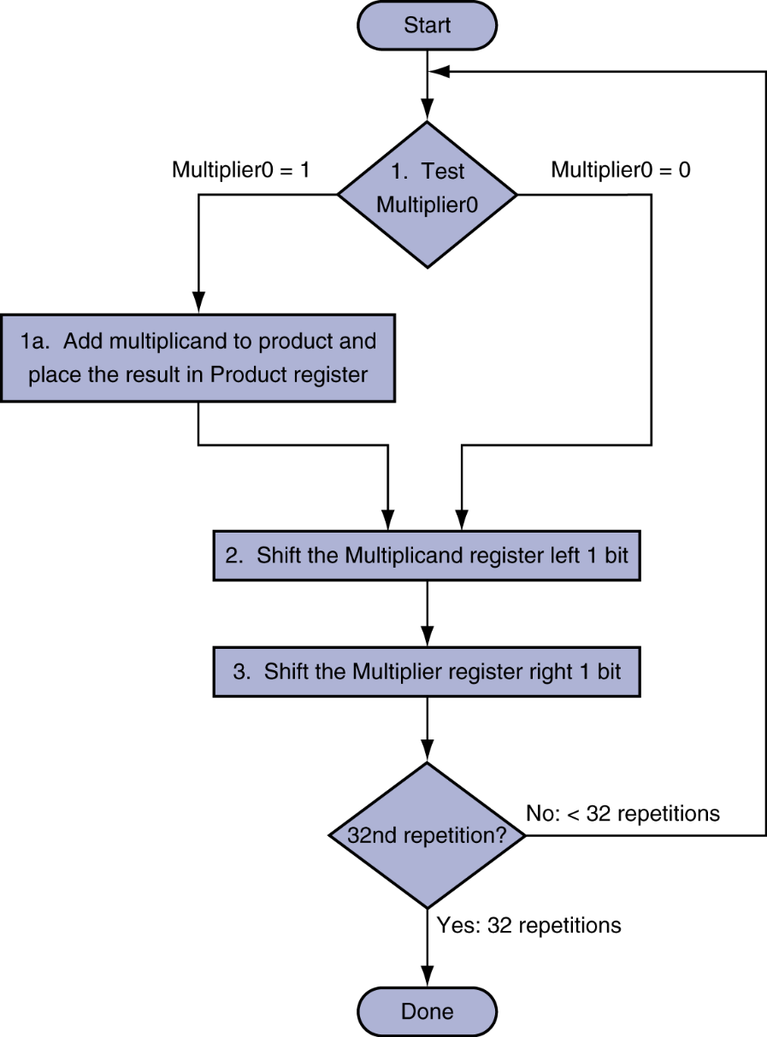
Multiplication Hardware (Long Multiplication)
Initially 0

Slide 11
Long Multiplication Approach
Multiplicand
1000 (8)
Multiplier
1001 (9)
Multiplicand
0000 1000
Multiplier
1001
Product
0000 0000
0000 1000
1001
0000 1000
1
0001 0000
1001
0000 1000
0001 0000
0100
0000 1000
0010 0000
0100
0000 1000
2
0010 0000
0010
0000 1000
0100 0000
0010
0000 1000
3
0100 0000
0001
0000 1000
0100 0000
0001
0100 1000
4
1000 0000
0001
0100 1000
1000 0000
0000
0100 1000
Number of iterations = Number of bits in multiplier

Slide 12
Multiplication
1000
Multiplicand
1001
Multiplier
1
0
0
0
0000
x
0000
x
x
1000
x
x
x
1001000

Slide 13
Multiplicand
01001 (9)
Multiplier
01010 (10)
Long Multiplication Approach
Multiplicand
00000 01001
Multiplier
01010
Product
00000 00000
1
00000 10010
00101
00000 00000
2
00001 00100
00010
00000 10010
3
00010 01000
00001
00000 10010
4
00100 10000
00000
00010 11010
5
01001 00000
00000
00010 11010
Number of iterations = Number of bits in multiplier

Slide 14

Multiplicand
000000 101100
Multiplier
010110
Product
000000 000000
1
000001 011000
001011
000000 000000
2
000010 110000
000101
0000001 011000
3
000101 100000
000010
000100 001000
4
001011 000000
000001
000100 001000
5
010110 000000
000000
001111 001000
6
101100 000000
000000
001111 001000

Slide 15
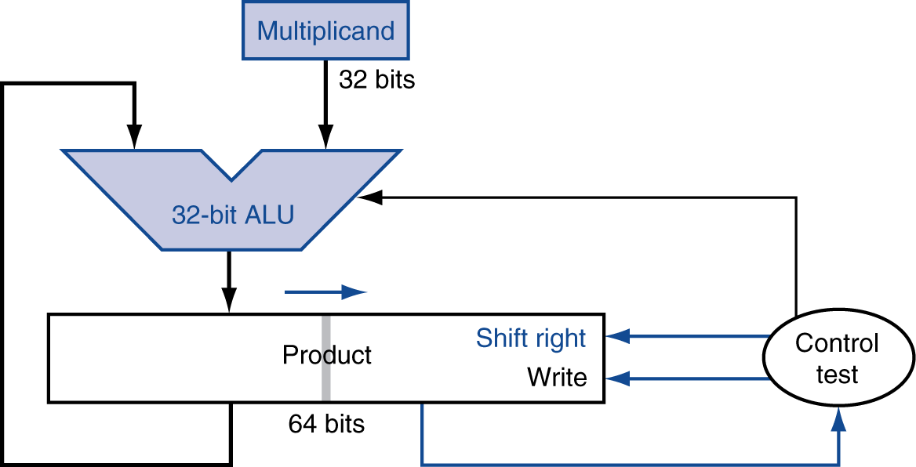
Optimized Multiplier
Perform steps in parallel: add/shift
One cycle per partial-product addition
That’s ok, if frequency of multiplications is low

Slide 16
No Changes here
Multiplier
1001 (9)
Optimized Multiplication Approach
Multiplicand
1000 (8)
Product LSB half bits = Multiplier bits
if iteration <= multiplier bit length
Multiplicand
1000
Product
0000 1001
1000 1001
if (last bit of multiplier = 1)
multiplicand + product MSB half bits
1 bit right shift product
1
1000
0100 0100
2
1000
0010 0010
3
1000
0001 0001
if (last bit of multiplier = 0)
1 bit right shift product
1001 0001
4
1000
0100 1000
Number of iterations = Number of bits in multiplier

Slide 17
No Changes here
Multiplier
1001 (9)
Optimized Multiplication Approach
Multiplicand
1000 (8)
Product LSB half bits = Multiplier bits
if iteration <= multiplier bit length
Multiplicand
1000
Product
0000 1001
1000 1001
if (last bit of multiplier = 1)
multiplicand + product MSB half bits
1 bit right shift product
1
1000
0100 0100
2
1000
0010 0010
3
1000
0001 0001
if (last bit of multiplier = 0)
1 bit right shift product
1001 0001
4
1000
0100 1000
Number of iterations = Number of bits in multiplier

Slide 18
Multiplicand
01001 (9)
Multiplier
01010 (10)
Optimized Multiplication Approach
Product LSB half bits = Multiplier bits
if iteration <= multiplier bit length
Multiplicand
01001
Product
00000 01010
1
01001
00000 00101
if (last bit of multiplier = 1)
multiplicand + product register MSB half bit
1 bit right shift product register
01001 00101
2
01001
00100 10010
3
01001
00010 01001
01011 01001
4
01001
00101 10100
if (last bit of multiplier =0)
1 bit Right Shift Product Register
5
01001
00010 11010
Number of iterations = Number of bits in multiplier

Slide 19
if iteration <= multiplier bit length
Product LSB half bits = Multiplier bits
Product
0000 1001
Multiplicand
1000
Product
0000 0110
Multiplicand
0110
if (last bit of multiplier = 1)
multiplicand + product register MSB half bit
1 bit right shift product register
1
0110
0000 0011
0110 0011
2
0110
0011 0001
1001 0001
3
0110
if (last bit of multiplier =0)
1 bit Right Shift Product Register
0100 1000
4
0110
0010 0100
Number of iterations = Number of bits in multiplier

Slide 20
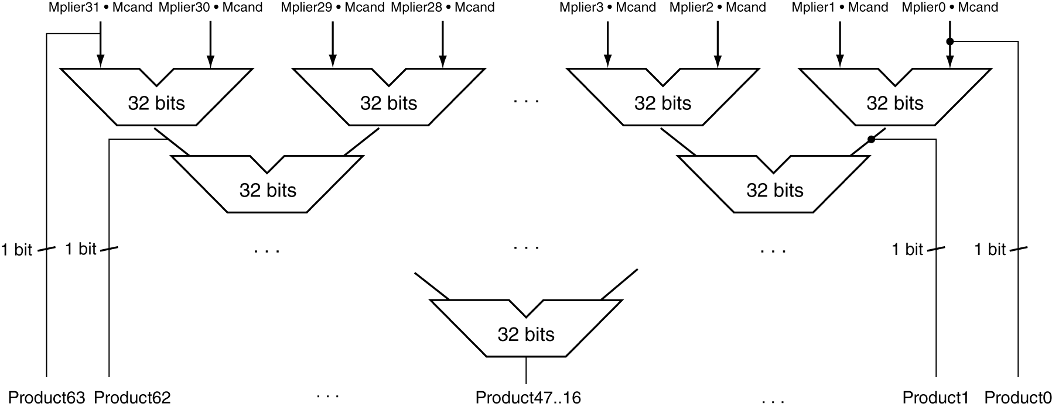
Faster Multiplier
Uses multiple adders
Cost/performance tradeoff
Can be pipelined
Several multiplication performed in parallel

Slide 21
MIPS Multiplication
Two 32-bit registers for product
HI: most-significant 32 bits
LO: least-significant 32-bits
Instructions
mult rs, rt / multu rs, rt
64-bit product in HI/LO
mfhi rd / mflo rd
Move from HI/LO to rd
Can test HI value to see if product overflows 32 bits
mul rd, rs, rt
Least-significant 32 bits of product –> rd

